Slide 1

Accelerated Baptist
Missions Institute
Helping your local church develop missionaries

Slide 2

The Commission
“…Go ye into all the world, and preach the gospel to every creature.”

Slide 3
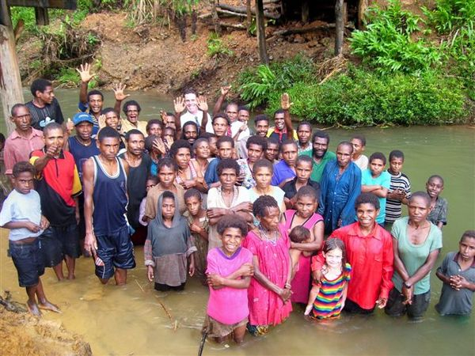
The Critical Responsibility
This command was given to us
It was given to each generation - Colossians 1:23/ Acts 13:36
We were given the power to complete it - Acts 1:8

Slide 4

The Reality
In 1950 there were 100,000 missionaries
Since 1950 we have lost 1,000 missionaries per year
Only 50 take their place
Today there are approximately 29,000 missionaries worldwide
There are only about 5,000 Independent Baptist Missionary families serving on foreign fields
30 countries still have no fundamental Baptist witness
2500 language groups have no Bible

Slide 5
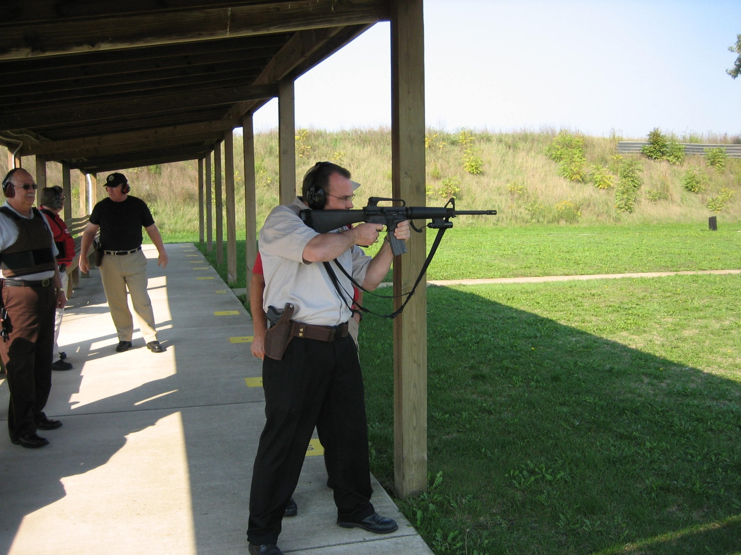
What do we do?

Slide 6
Training
“The same commit thou to faithful men, who shall be able to teach others also.”

Slide 7
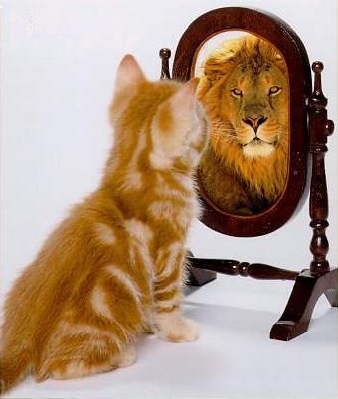
How?
Less than 1% of students attending a Bible College ever consider the mission field

Slide 8
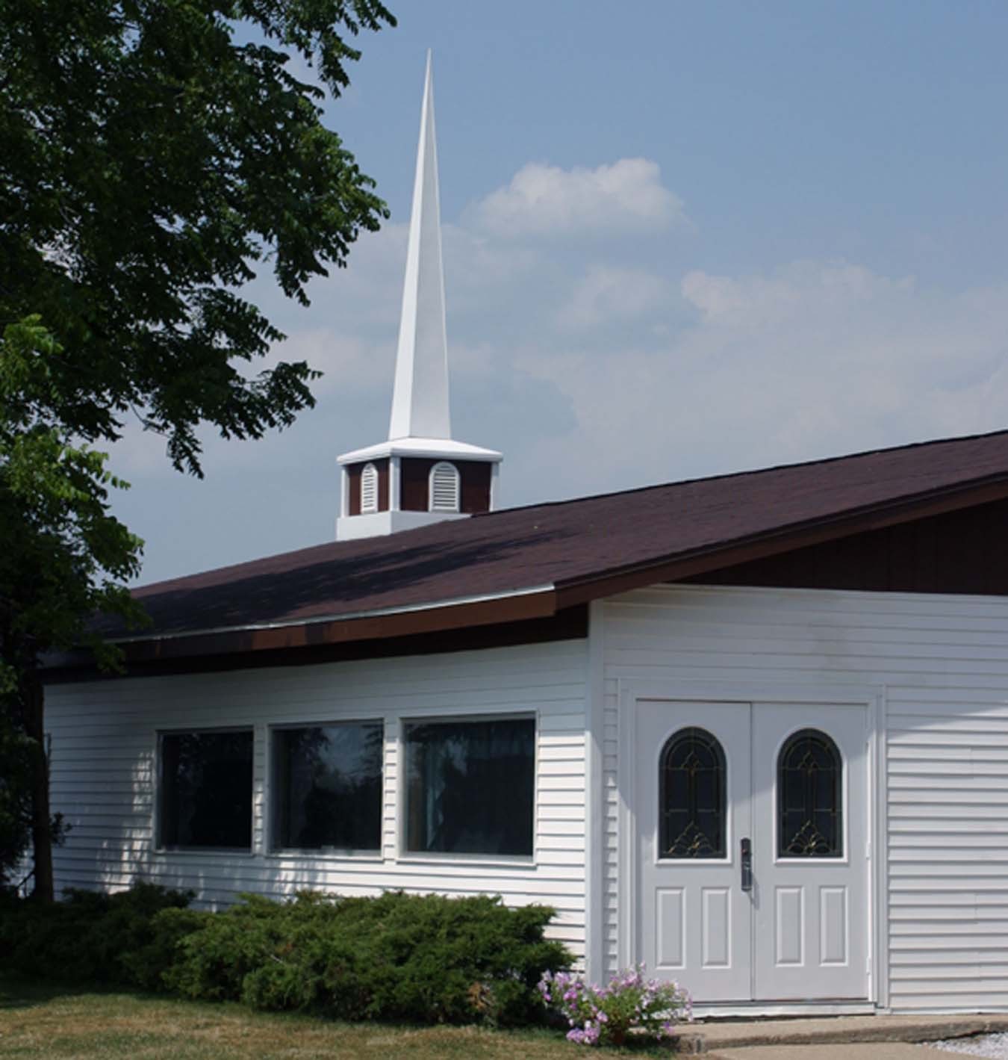
God put a plan in place
“To the intent that now unto the principalities and powers in heavenly places might be known by the church the manifold wisdom of God, According to the eternal purpose which he purposed in Christ Jesus our Lord.” Ephesians 3:10-11

Slide 9

The Plan was simple
Preach the Cross
Teach others to
Preach the Cross

Slide 10
The Organization with God’s complete support…
The Local Church

Slide 11
Why ABMI?

Slide 12

To Provide the
Local Church
With
Tools to Train
Missionaries

Slide 13
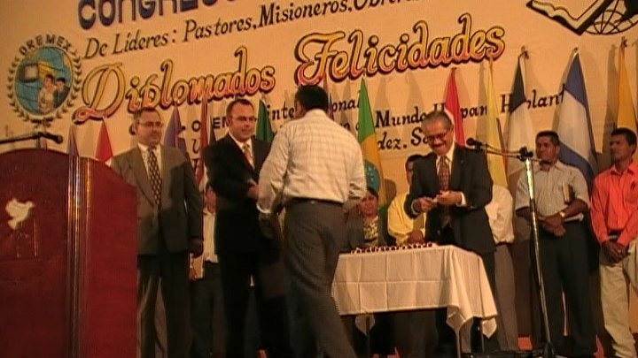
The Vision
There are 13,000 Fundamental Baptist Churches in America
If just 5,000 of those would start a missionary focused Bible Institute
And each of those produced just one missionary
In three years we
would double the amount
of FBM’s on the field

Slide 14
How are we
going to reach
This goal

Slide 15
Locally
We are providing a local institute that is ministry focused here at Silvery Lane Baptist Church
Our students will all remain in their own local church while they are learning.
We are a targeted supplement to the preaching of the local church pastor

Slide 16
Nationally
We are providing all of the materials necessary for local churches to start their own targeted Institutes.
By helping with record keeping, scheduling, and curriculum we are helping local churches to focus on the responsibility of the great commission

Slide 17
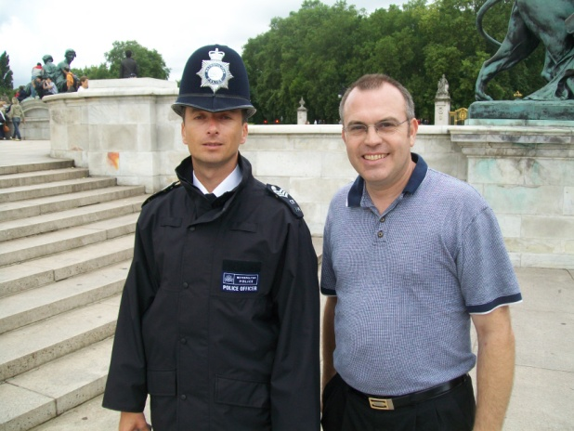
The ABMI Program
2 years of lectures
3rd year practical application
A focused curriculum
3 different majors
  Foreign Missions
  Home Missions
  Lay Missions
Well planned
Good Records

Slide 18
Lectures
One class each night
Three nights each week
Teachers taken from your local church
Can co-op with other local pastor’s

Slide 19
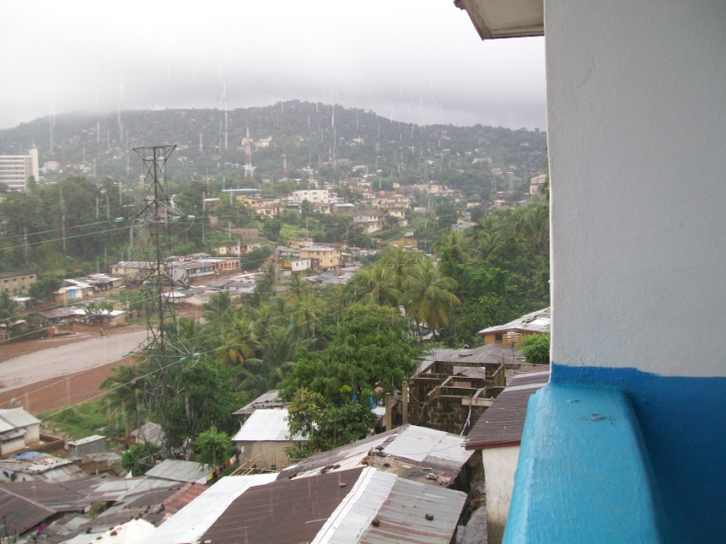
Pod Classes
A stream can only become a river if it has outside tributaries contributing to it
12 weeks in the two-year lecture cycle can be pre-empted by a guest lecturer
They will have a total of 6 hours in a week to teach what they know about a given subject
2 weeks @ semester has a specific subject – 1 week @ semester is open

Slide 20
The Manual
A complete start-up kit
Suggested curriculum
Suggested schedule
Teachers planners
Record keeping forms
All in one, affordable, reproducible book

Slide 21

Keep it Simple
Cost Structure
$100 registration fee
$100 each month for 9 months
Auditing
  $100 registration
  $100 per class

Slide 22
Is ABMI worth the effort?
Pray ye the Lord of the Harvest and He will send laborers – that is a promise!
Using God’s methods will always produce God size results!
ABMI is worth your support and consideration because it focuses on God’s methods of evangelism.

Slide 23
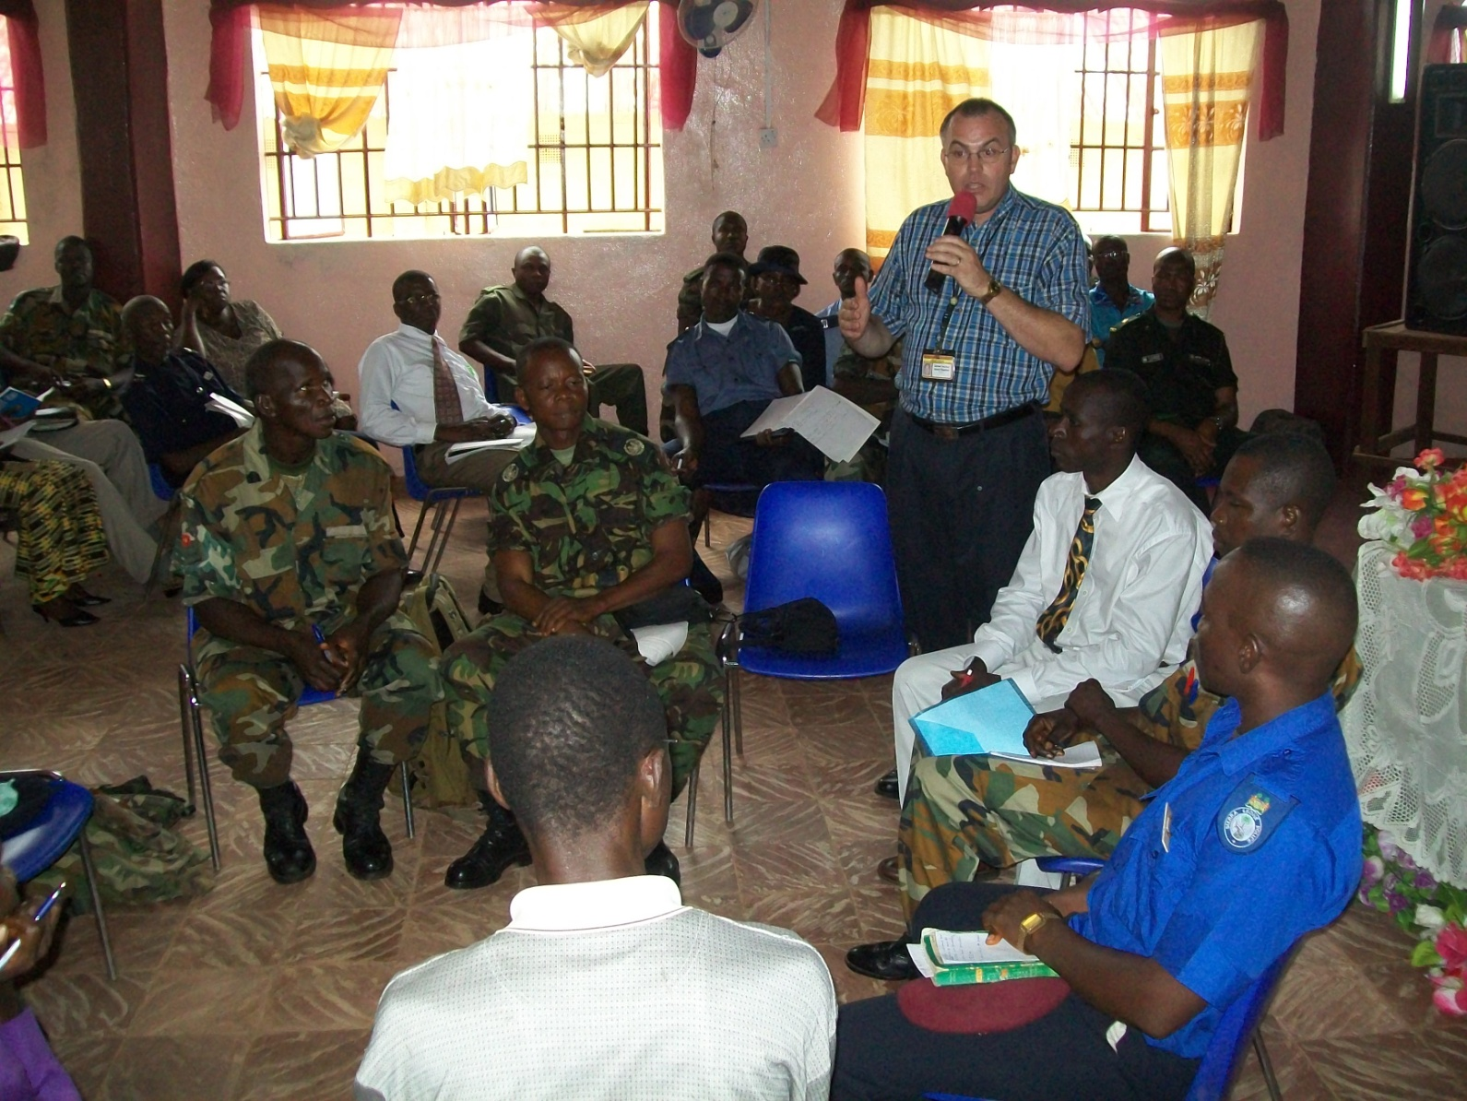
This Generation
MUST Reach
This Generation

